Slide 1


AAPNIPARKING
Vehicle Parking Management
Project
Company Name : Scifor Technologies
Trainer Name: Farzana Rashid
By: Nehal Gupta
ID: MST01-0019

Slide 2

Project Overview
AapniParking project aims to provide a fully featured comprehensive vehicle parking management website .
The projects integrates Django framework along with bootstrap for frontend styling and give good user experience to the one using it. It has lots of functionalities like book parking slot, add vehicle, add parking space ,login page, registration page, generate booking receipt functionality, which makes it an overall good website.

Slide 3

Table of contents
1 Introduction
2 Objective
3 Technologies Used
4 System Architecture
5 How it Works
6 References

Slide 4
Introduction
The AapniParking project is a fully functional parking management website developed using Django web framework with HTML and bootstrap used for frontend styling . It contains lots of functionalities like add new vehicle, book parking slot, view and manage vehicles, dashboard for users and similarly for admin all these functionalities is there with some more features like generate invoice, add parking space with a good UI to give an overall good and smooth experience to users using it.

Slide 5
Objective
The objective of creating this website is to provide users with a all in one website where they can book parking slot, manage their vehicles , manage their vehicle parking easily with an ease and convenience to use. It has an very attractive UI with good interaction and responsiveness so user don’t face any issue and can book slot in few seconds which saves user time.

Slide 6



Technologies Used
Django 5.0: Django is a high-level Python web framework that enables rapid development of secure and maintainable websites. It works on MVT architecture and provides built-in features for everything including Django Admin Interface, default database – SQLlite3.
Bootstrap is a popular front-end framework that helps to create responsive web designs. It is a powerful, extensible, and feature-packed frontend toolkit. It provides
pre-designed templates and components using HTML, CSS, and JavaScript for creating good and responsive user interfaces.
HTML stands for HyperText Markup Language. It is the standard markup language used to create web pages. It creates a standard structure and uses tags to display images, links, text and other multimedia content on the web
SQLite is a software library that implements a small, fast, self-contained, high reliability, full featured, SQL database engine. It is the default database engine used in Django web framework.

Slide 7



Technologies Used
CSS (Cascading Style Sheets) is simply designed language intended to simplify the process of making web pages presentable. It allows us to apply styles to HTML documents and make the pages look more presentable and styled. It describes how a webpage should look.
JavaScript is a lightweight interpreted programming language which is use to add interactivity, dynamic behavior, and functionality to web pages. It allows developers to manipulate the HTML and CSS of a webpage, handle user interactions or overall client side webpage behavior.
Query is a fast, small, and feature-rich JavaScript library. It makes things like HTML document traversal and manipulation, event handling, and Ajax much simpler with an easy-to-use API.

Slide 8
System Architecture
MVT Architecture
MVT stands for Model-View-Template and Django uses this architecture for working. It is a software design pattern which is a collection of three important components Model View and Template.
Model
View
Template
The model defines the database and data structure. It maintains and handle the database. It is a data access layer.
It is responsible for handling user requests and returning the response as per the request. It is used to execute the business logic and interact with model to carry data and renders a template.
The Template is a presentation layer which handles how the render page User Interface will look, styled. It consists of static parts of the desired HTML output as well as some special syntax describing how dynamic content will be inserted.

Slide 9
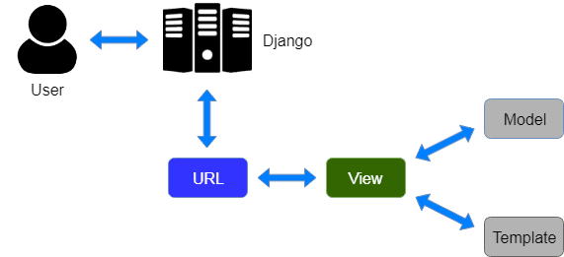
MVT Architecture Structure

Slide 10
It’s working
Home / Dashboard Page
Functionality: Dynamically displays values according to the user logged in is customer or an admin. With a good interactive user interface which is built using Django modules, Bootstrap, HTML, CSS.
Technologies Used
Frontend: HTML, CSS, JavaScript , Bootstrap
Backend: Django

Slide 11
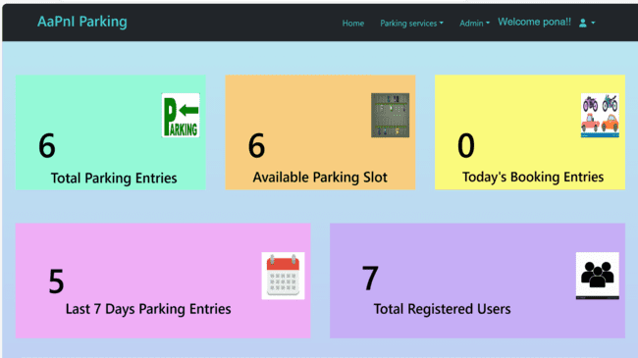

Slide 12
Book Parking Slot Page
Functionality: Renders a html form which takes input with responsive layout with bootstrap styling.
Technologies Used
Frontend: HTML, CSS, Bootstrap
Backend: Django, Django Forms, Django Models
Model Fields
vehicle_uniqueid=Foreignkey
veh_model= CharField
slot_no=ForeignKey
owner_name= CharField
veh_registration= CharField

Slide 13
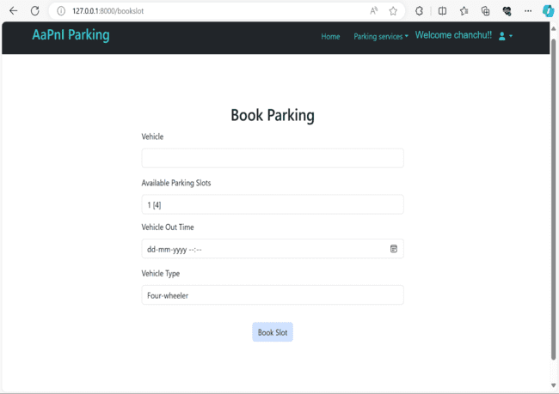
owner_contactno= CharField
parking_rate=IntegerField
intime=DateTimeField
outtime= DateTimeField
fee= FloatField
vehicle_type= CharField
booking_user=ForeignKey
parking_date= DateField

Slide 14
Add Parking Space Page
Functionality: Renders a html form which takes input with responsive layout and bootstrap styling for both user and admin.
Technologies Used
Frontend: HTML, CSS, Bootstrap
Backend: Django, Django Forms, Django Models
Model Fields
no = BigAutoField
veh_type = CharField
is_available = BooleanField

Slide 15
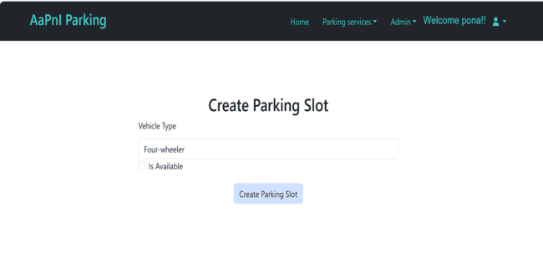

Slide 16
Add Vehicle Page
Functionality: Renders a html form which takes input with responsive layout and bootstrap styling for both user and admin.
Technologies Used
Frontend: HTML, CSS, Bootstrap
Backend: Django, Django Forms, Django Models
Model Fields
veh_registration_no= CharField
veh_model= CharField
owner= CharField
contact= CharField
vehicle_category= CharField
remark= TextField
created_by= ForeignKey

Slide 17
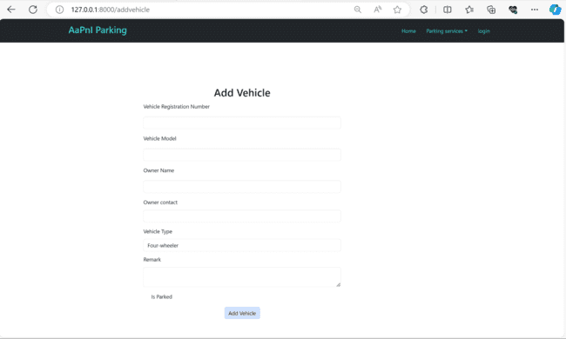

Slide 18
Detail Parking Page
Functionality: A detail page which displays dynamic information related to parking with an attractive User Interface which works smoothly and for admin have a feature of modifying the data and generate booking receipt.
Technologies Used
Frontend: HTML, CSS, Bootstrap
Backend: Django

Slide 19
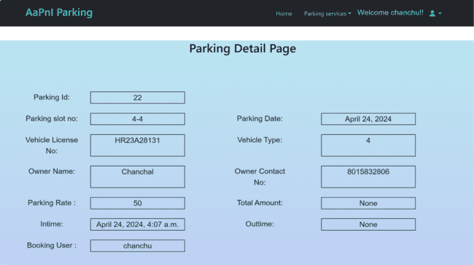

Slide 20
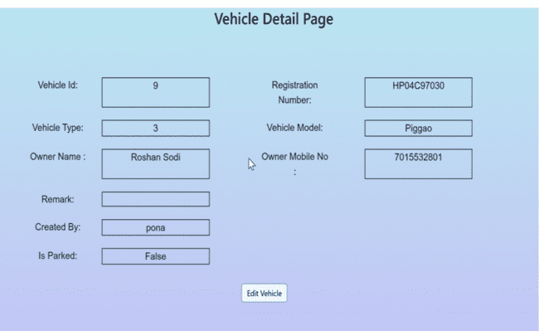
Detail Vehicle Page
Functionality: A detail page which displays dynamic information related to vehicle and give feature of editing the information with an attractive User Interface with smooth working.
Technologies Used
Frontend: HTML, CSS, Bootstrap
Backend: Django

Slide 21
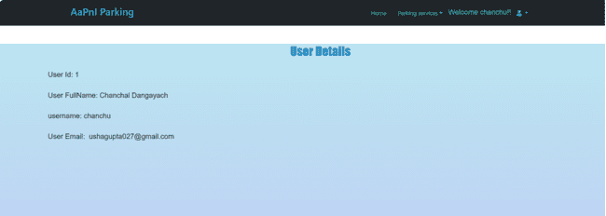
User Detail Page
Functionality: User detail page displays user information with a user friendly User Interface.
Technologies Used
Frontend: HTML, CSS, Bootstrap
Backend: Django

Slide 22
View Vehicles Page
Functionality: Renders dynamic data in the form of table with options to delete and modify data with an smooth UI part created using html, CSS. It also has search functionality to search within the table using javascript.
Technologies Used
Frontend: HTML, CSS, JavaScript , Bootstrap
Backend: Django

Slide 23
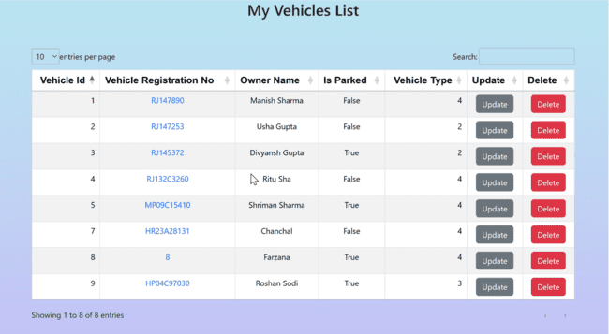

Slide 24
ViewParkings / Manage Parking Page
Functionality: Renders dynamic data according to the user logged in in the form of table with options to delete and modify the data, even search functionality with a good UI part created using html, CSS, javascript.
Technologies Used
Frontend: HTML, CSS, JavaScript , Bootstrap
Backend: Django

Slide 25
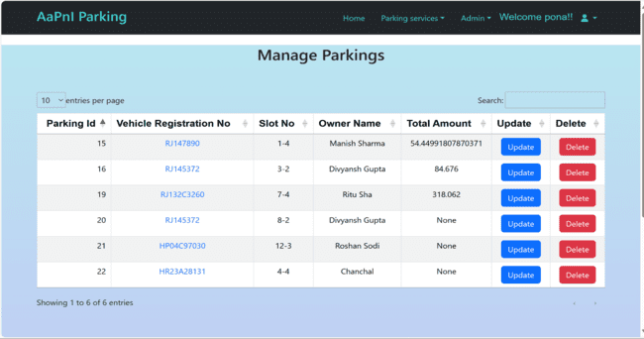

Slide 26
View ParkingSpace Page
Functionality: Renders parking space data with search functionality in the form of table with options to delete and modify the data with a good UI part created using html, CSS.
Technologies Used
Frontend: HTML, CSS, JavaScript , Bootstrap
Backend: Django

Slide 27
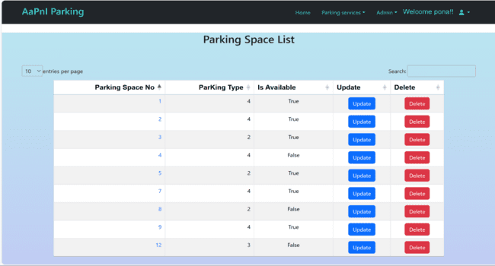

Slide 28
User Registration Page
Functionality: Renders an html form to take input with a smooth user interface working. It provides user with functionality to create their account for logging purpose.
Technologies Used:
Frontend: HTML, CSS, Bootstrap
Backend: Django, Django built in User model

Slide 29
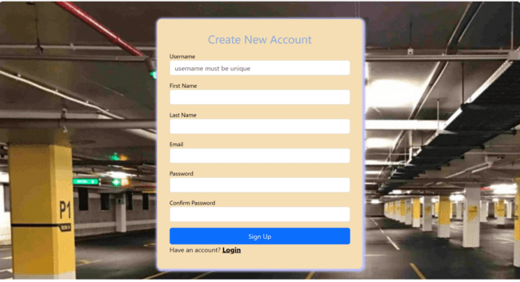

Slide 30
Login Page
Functionality: Renders an html form with an enhanced user interface with login functionality using Django built in authentication system.
Technologies Used
Frontend: HTML, CSS, Bootstrap
Backend: Django, Django built in User model, Django Authentication System

Slide 31
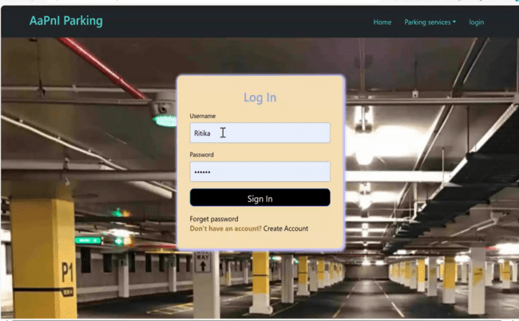

Slide 32
Forget Password Page
Renders an html form with changing password functionality with an enhanced user interface using Bootstrap, HTML, CSS.
Technologies Used
Frontend: HTML, CSS, Bootstrap
Backend: Django

Slide 33
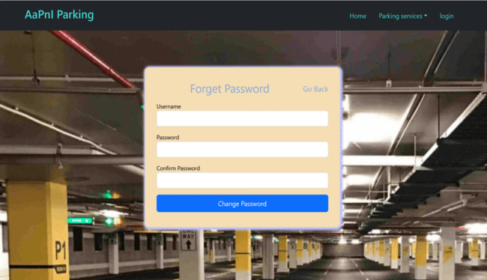

Slide 34
References
1.Django Documentation: [https://docs.djangoproject.com/en/5.0/]
2.BootstrapDocumentation:[https://getbootstrap.com/docs/5.0/gettingstarted/introduction/]
3. MDB Docs: [https://mdbootstrap.com/docs/standard/]
4. ReportLab: [https://docs.reportlab.com/reportlab/userguide/

Slide 35
Thanks for watching

